Slide 1

Decision Tree
Lecture 4 Instruction
Introduction to Data Science (IDS) course

Slide 2
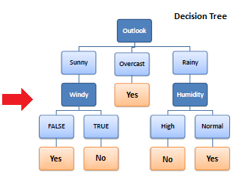
ID3 Complete example
Descriptive Features
Target Features
Outlook | Temp | Humidity | Windy | Play Golf
Rainy | Hot | High | False | No
Rainy | Hot | High | True | No
Overcast | Hot | High | False | Yes
Sunny | Mild | High | False | Yes
Sunny | Cool | Normal | False | Yes
Sunny | Cool | Normal | True | No
Overcast | Cool | Normal | True | Yes
Rainy | Mild | High | False | No
Rainy | Cool | Normal | False | Yes
Sunny | Mild | Normal | False | Yes
Rainy | Mild | Normal | True | Yes
Overcast | Mild | High | True | Yes
Overcast | Hot | Normal | False | Yes
Sunny | Mild | High | True | No

Slide 3
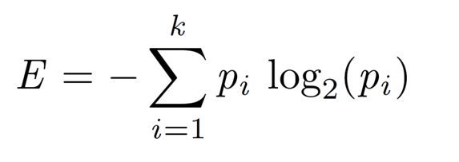
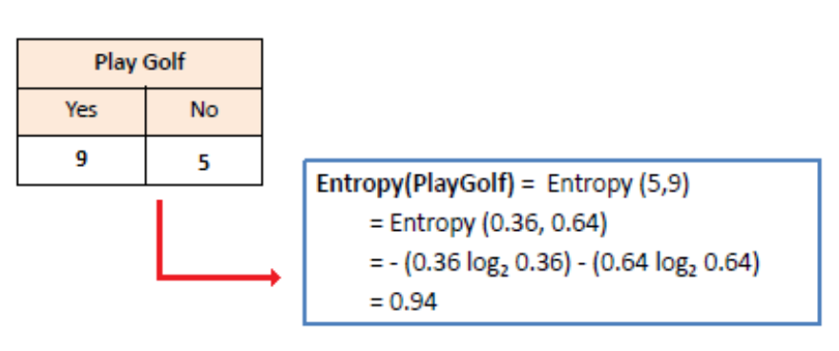
ID3 Complete example
1. Calculating entropy of the target feature
Outlook | Temp | Humidity | Windy | Play Golf
Rainy | Hot | High | False | No
Rainy | Hot | High | True | No
Overcast | Hot | High | False | Yes
Sunny | Mild | High | False | Yes
Sunny | Cool | Normal | False | Yes
Sunny | Cool | Normal | True | No
Overcast | Cool | Normal | True | Yes
Rainy | Mild | High | False | No
Rainy | Cool | Normal | False | Yes
Sunny | Mild | Normal | False | Yes
Rainy | Mild | Normal | True | Yes
Overcast | Mild | High | True | Yes
Overcast | Hot | Normal | False | Yes
Sunny | Mild | High | True | No

Slide 4
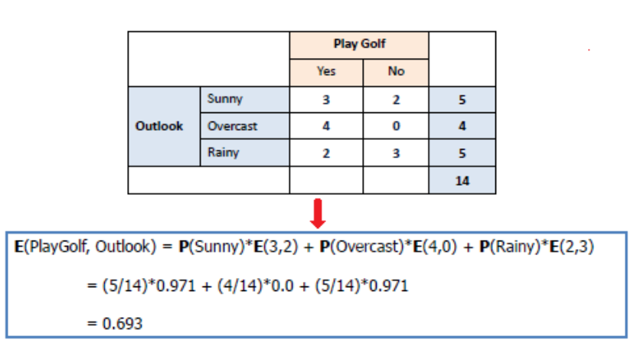
ID3 Complete example
2. Entropy after splitting by “outlook”
Outlook | Temp | Humidity | Windy | Play Golf
Rainy | Hot | High | False | No
Rainy | Hot | High | True | No
Overcast | Hot | High | False | Yes
Sunny | Mild | High | False | Yes
Sunny | Cool | Normal | False | Yes
Sunny | Cool | Normal | True | No
Overcast | Cool | Normal | True | Yes
Rainy | Mild | High | False | No
Rainy | Cool | Normal | False | Yes
Sunny | Mild | Normal | False | Yes
Rainy | Mild | Normal | True | Yes
Overcast | Mild | High | True | Yes
Overcast | Hot | Normal | False | Yes
Sunny | Mild | High | True | No

Slide 5
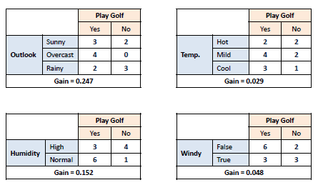
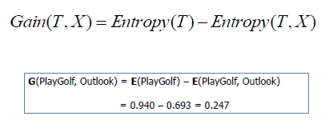
ID3 Complete example
3. Calculating information gain after splitting by each descriptive feature
Outlook | Temp | Humidity | Windy | Play Golf
Rainy | Hot | High | False | No
Rainy | Hot | High | True | No
Overcast | Hot | High | False | Yes
Sunny | Mild | High | False | Yes
Sunny | Cool | Normal | False | Yes
Sunny | Cool | Normal | True | No
Overcast | Cool | Normal | True | Yes
Rainy | Mild | High | False | No
Rainy | Cool | Normal | False | Yes
Sunny | Mild | Normal | False | Yes
Rainy | Mild | Normal | True | Yes
Overcast | Mild | High | True | Yes
Overcast | Hot | Normal | False | Yes
Sunny | Mild | High | True | No
Maximum Gain

Slide 6

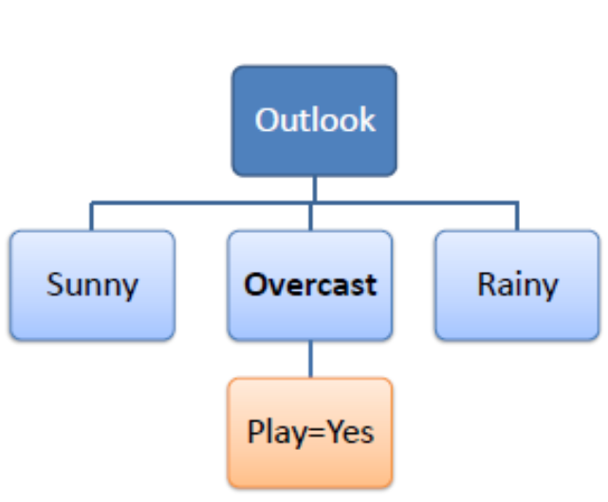



ID3 Complete example
Outlook | Temp | Humidity | Windy | Play Golf
Sunny | Mild | High | False | Yes
Sunny | Cool | Normal | False | Yes
Sunny | Cool | Normal | True | No
Sunny | Mild | Normal | False | Yes
Sunny | Mild | High | True | No
4. Split data based on the feature which has the maximum gain, and repeat steps 1-3 for each part.
Overcast | Hot | High | False | Yes
Overcast | Cool | Normal | True | Yes
Overcast | Mild | High | True | Yes
Overcast | Hot | Normal | False | Yes
Rainy | Hot | High | False | No
Rainy | Hot | High | True | No
Rainy | Mild | High | False | No
Rainy | Cool | Normal | False | Yes
Rainy | Mild | Normal | True | Yes

Slide 7
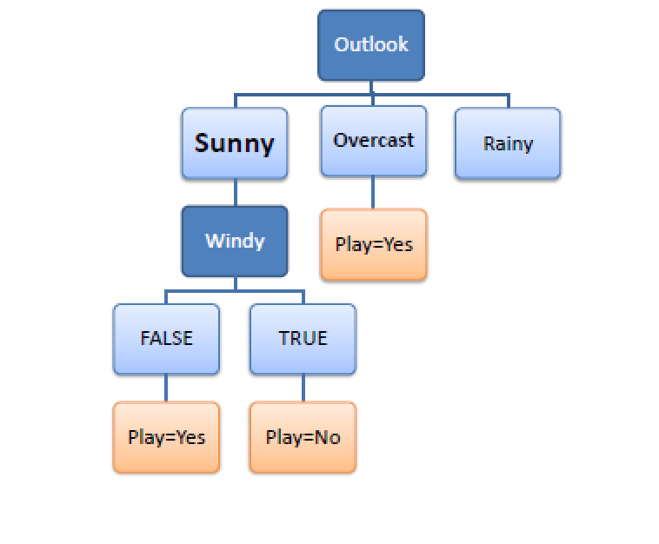
ID3 Complete example
Outlook | Temp | Humidity | Windy | Play Golf
Sunny | Mild | High | False | Yes
Sunny | Cool | Normal | False | Yes
Sunny | Cool | Normal | True | No
Sunny | Mild | Normal | False | Yes
Sunny | Mild | High | True | No
Overcast | Hot | High | False | Yes
Overcast | Cool | Normal | True | Yes
Overcast | Mild | High | True | Yes
Overcast | Hot | Normal | False | Yes
Rainy | Hot | High | False | No
Rainy | Hot | High | True | No
Rainy | Mild | High | False | No
Rainy | Cool | Normal | False | Yes
Rainy | Mild | Normal | True | Yes

Slide 8
ID3 Complete example
Outlook | Temp | Humidity | Windy | Play Golf
Sunny | Mild | High | False | Yes
Sunny | Cool | Normal | False | Yes
Sunny | Cool | Normal | True | No
Sunny | Mild | Normal | False | Yes
Sunny | Mild | High | True | No
Overcast | Hot | High | False | Yes
Overcast | Cool | Normal | True | Yes
Overcast | Mild | High | True | Yes
Overcast | Hot | Normal | False | Yes
Rainy | Hot | High | False | No
Rainy | Hot | High | True | No
Rainy | Mild | High | False | No
Rainy | Cool | Normal | False | Yes
Rainy | Mild | Normal | True | Yes

Slide 9
Your Turn
Suppose that following data is about accepting or rejecting job applications based on “Experience”, “Degree”, and type of the job (“Job”) that applicants applied for it. What is the best decision tree for the following data set based on entropy?
Experience | Degree | Job | Class
Exp >10 | HS | Board | -
5< Exp <10 | Uni | Board | +
Exp >10 | HS | Board | -
5< Exp <10 | HS | Hcare | +
Exp < 5 | HS | Hcare | +
Exp < 5 | HS | Board | -
Exp < 5 | None | Edu | -
Exp >10 | None | Hcare | -
Exp < 5 | Uni | Edu | +
Exp >10 | Uni | Board | +

Slide 10
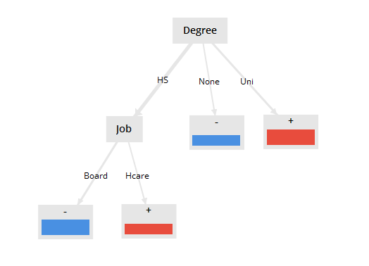
Your Turn
Answer
Experience | Degree | Job | Class
Exp >10 | HS | Board | -
5< Exp <10 | Uni | Board | +
Exp >10 | HS | Board | -
5< Exp <10 | HS | Hcare | +
Exp < 5 | HS | Hcare | +
Exp < 5 | HS | Board | -
Exp < 5 | None | Edu | -
Exp >10 | None | Hcare | -
Exp < 5 | Uni | Edu | +
Exp >10 | Uni | Board | +

Slide 11
Dealing with numerical descriptive features
What are possible categories for “Experience” feature?
Experience | Degree | Job | Class
12 | HS | Board | -
20 | Uni | Board | +
15 | HS | Board | -
10 | HS | Hcare | +
3 | HS | Hcare | -
7 | HS | Board | +
5 | None | Edu | -
2 | None | Hcare | -
6 | Uni | Edu | +
11 | Uni | Board | +

Slide 12
Dealing with numerical descriptive features
Sorting data based on the numerical feature and selecting borders in between the target feature
Experience | Degree | Job | Class
12 | HS | Board | -
20 | Uni | Board | +
15 | HS | Board | -
10 | HS | Hcare | +
3 | HS | Hcare | -
7 | HS | Board | +
5 | None | Edu | -
2 | None | Hcare | -
6 | Uni | Edu | +
11 | Uni | Board | +
Experience | Degree | Job | Class
2 | None | Hcare | -
3 | HS | Hcare | -
5 | None | Edu | -
6 | Uni | Edu | +
7 | HS | Board | +
10 | HS | Hcare | +
11 | Uni | Board | +
12 | HS | Board | -
15 | HS | Board | -
20 | Uni | Board | +
Experience < 6
6 <= Experience < 12
Sort based on “Experiences”
12 <= Experience < 20
Experience >= 20

Slide 13
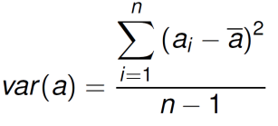
Dealing with numerical target feature
Suppose that we have following leaves after splitting the data set. Which classification is better and why?
Descriptive Features
Target Features
Experience | Degree | Job | Salary (K)
12 | HS | Board | 20
20 | Uni | Board | 40
15 | HS | Board | 50
10 | HS | Hcare | 65
3 | HS | Hcare | 70
7 | HS | Board | 25
5 | None | Edu | 95
2 | None | Hcare | 100
6 | Uni | Edu | 110
11 | Uni | Board | 45
Leaf 1
20
100
40
95
Leaf 2
50
65
70
110
Leaf 3
45
25
Leaf 1
70
100
110
95
Leaf 2
40
45
65
50
Leaf 3
25
20

Slide 14
Dealing with numerical target feature
Suppose that we have following leaves after splitting the data set. Which classification is better and why?
Descriptive Features
Target Features
Experience | Degree | Job | Salary (K)
12 | HS | Board | 20
20 | Uni | Board | 40
15 | HS | Board | 50
10 | HS | Hcare | 65
3 | HS | Hcare | 70
7 | HS | Board | 25
5 | None | Edu | 95
2 | None | Hcare | 100
6 | Uni | Edu | 110
11 | Uni | Board | 45
Leaf 1
20
100
40
95
1192.1875
Leaf 2
50
65
70
110
492.1875
Leaf 3
45
25
100
Leaf 1
70
100
110
95
217.1875
Since variances are better, this classification is better
Leaf 2
40
45
65
50
87.5
Leaf 3
25
20
6.25

